Slide 1
Fitness Buddy- Your AI-powered health and fitness companion
CAPSTONE PROJECT
Presented By:
1. Esha Singh- Vivekananda Institute of Professional Studies- Vivekananda School of Information Technology (VSIT)

Slide 2
OUTLINE
Problem Statement (Should not include solution)
Proposed System/Solution
System Development Approach (Technology Used)
Algorithm & Deployment
Result (Output Image)
Conclusion
Future Scope
References

Slide 3
Problem Statement 13 – Fitness buddy
The challenge - In today’s fast-paced world, many individuals struggle to maintain a healthy lifestyle due to lack of personalized guidance, time constraints, and inconsistent motivation. Traditional fitness solutions often require expensive subscriptions, in-person consultations, or rigid schedules that don't adapt to personal preferences or daily routines. There is a growing need for an accessible, friendly, and intelligent virtual assistant that can provide on demand fitness advice, healthy lifestyle suggestions, and basic nutrition guidance—all tailored to individual needs and available at any time. Fitness Buddy aims to solve this problem by offering a conversational, AI-powered health and fitness coach that can:
Recommend home workouts and routines based on user input.
• Provide motivational tips and daily fitness inspiration.
• Suggest simple, nutritious meal ideas.
• Encourage habit-building and consistency.
Technology: Use of IBM cloud lite services /IBM Granity is mandatory

Slide 4
Proposed Solution
Title: AI-Powered Fitness Buddy Using IBM Watsonx.ai
Solution Overview:
A conversational AI agent built on IBM Watsonx.ai to provide personalized fitness guidance, nutrition plans, and motivational support.
Leverages Mistral-large foundation model and agentic AI for dynamic interactions.
Key Features:
Dynamic Workouts: Recommends routines based on time, equipment, and goals (e.g., *"20-min home workout with no equipment"*).
Nutrition Guidance: Suggests meal plans with dietary restrictions (e.g., *"gluten-free lunch under 500 calories"*).
Motivational Support: Provides habit-building tips and quotes (e.g., *"30-day challenge for consistency"*).

Slide 5
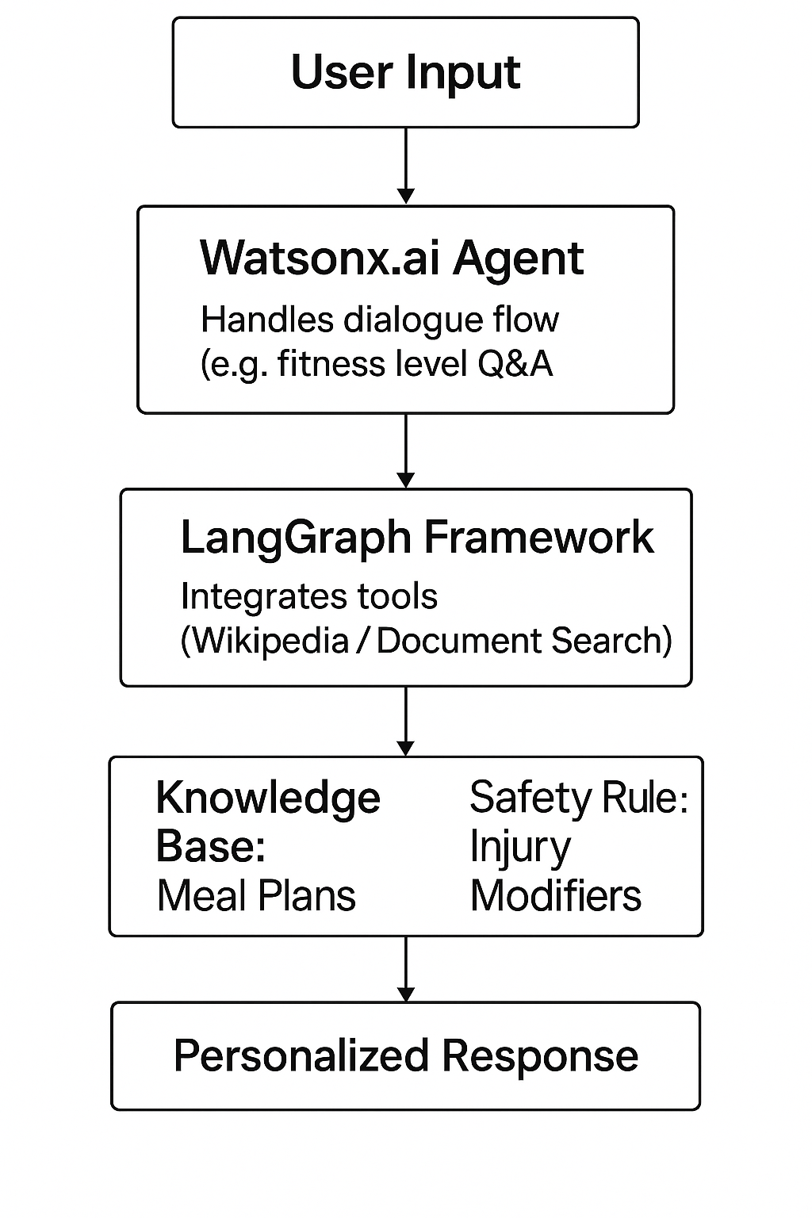
System Approach
Title: Technology Stack & Implementation Content:
Platform: IBM Cloud (Lite Plan) with Watsonx.ai Agent Lab.
Framework: LangGraph
Architecture: ReAct
Tools Used:
Foundation Model: Mistral-large for generative responses.
Integrated Tools:
Wikipedia Search: General fitness knowledge.
Document Search: Curated meal plans.
Webcrawler: Real-time nutrition data.
Workflow:
User inputs query (e.g., "Beginner yoga routine").
AI asks clarifying questions (fitness level, equipment).
Generates structured response (warm-up/main/cool-down).

Slide 6
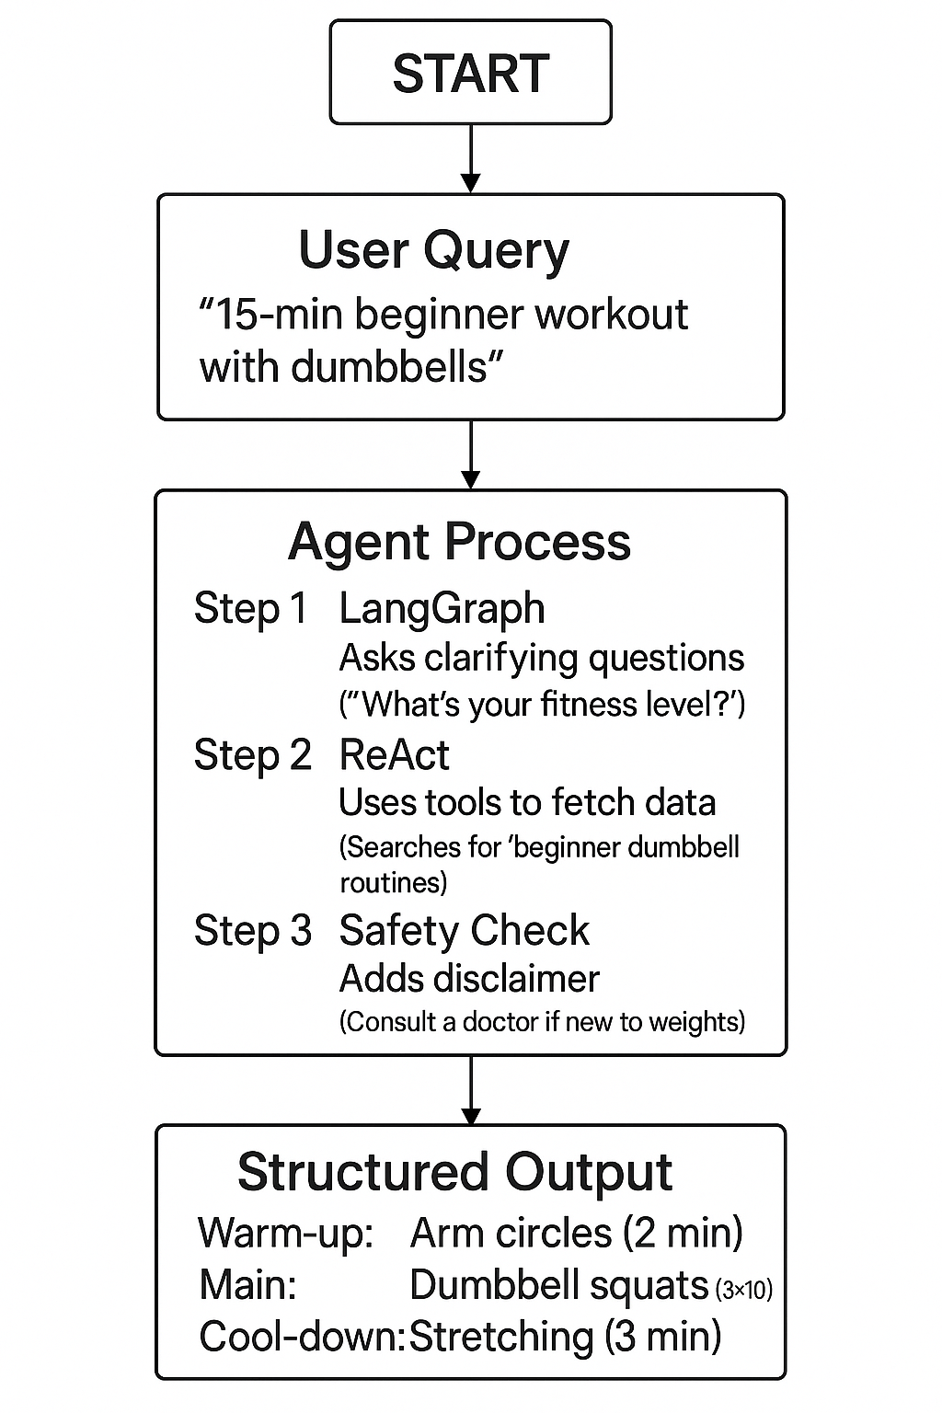
Algorithm & Deployment
Title: Agent Configuration & Deployment Content:
Algorithm:
Prompt Engineering: Rules-based instructions (e.g., "Always ask 3 questions before answering").
Tool Integration: Function calling for external data (e.g., calorie counts).
Deployment Steps:
Created Cloud Object Storage (Lite Plan).
Configured Watsonx.ai Runtime service.
Deployed as an AI service with API access.

Slide 7
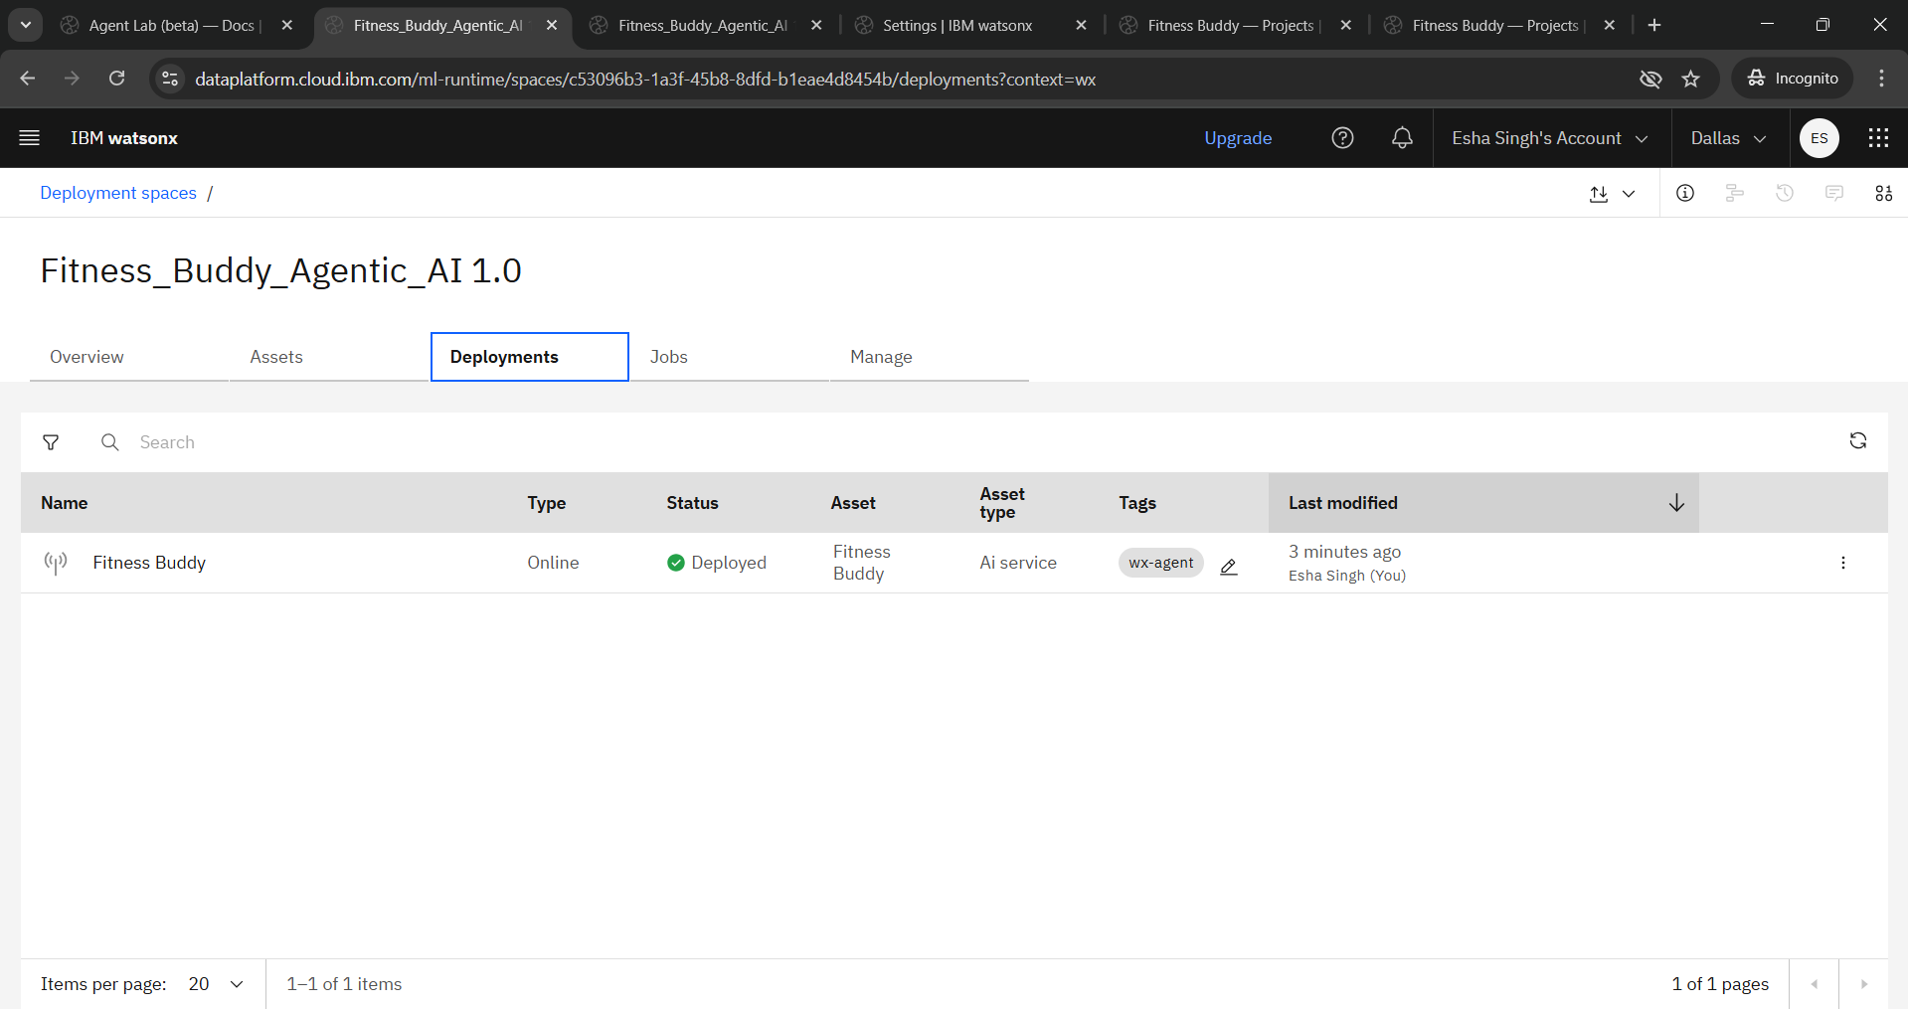
Algorithm & Deployment
Visual:

Slide 8
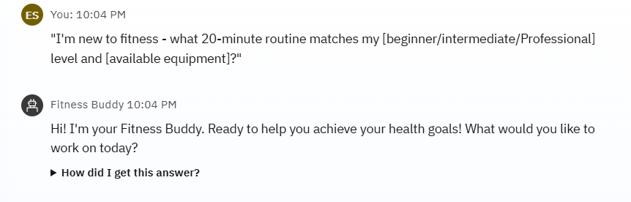
Result
"I'm new to fitness - what 20-minute routine matches my [beginner/intermediate/Professional] level and [available equipment]?“

Slide 9
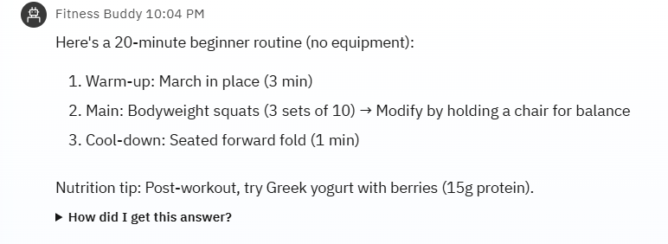
Result
"I want to do muscle gain workout “

Slide 10
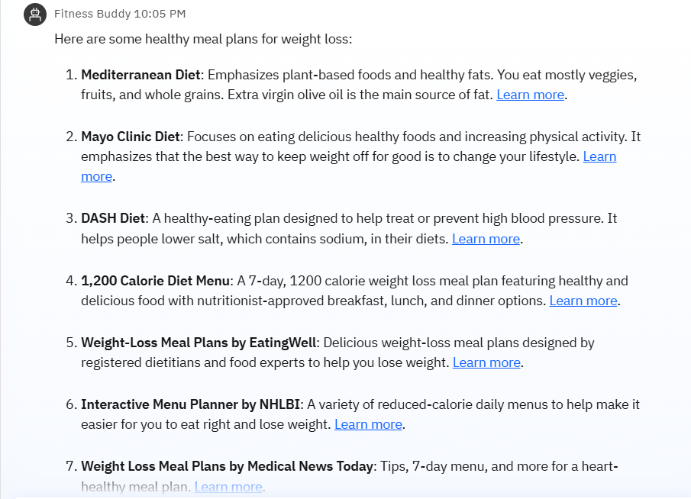
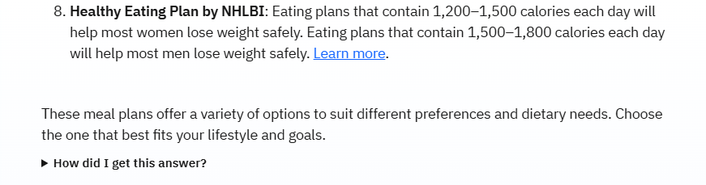
Result
"Suggest a healthy meal plan for weight loss “

Slide 11
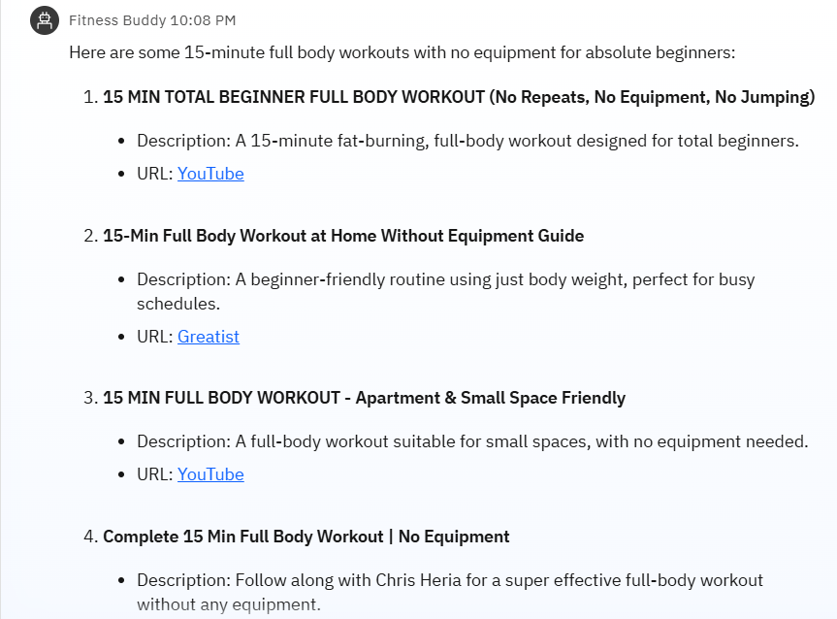
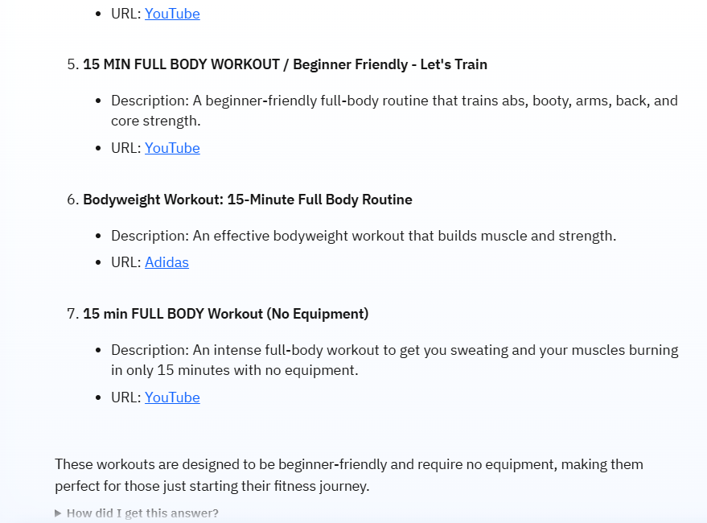
Result
"Show me a 15-minute full body workout with no equipment for absolute beginners “

Slide 12
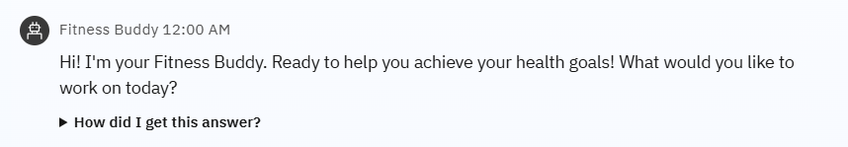
Result
"I want to get fit”

Slide 13
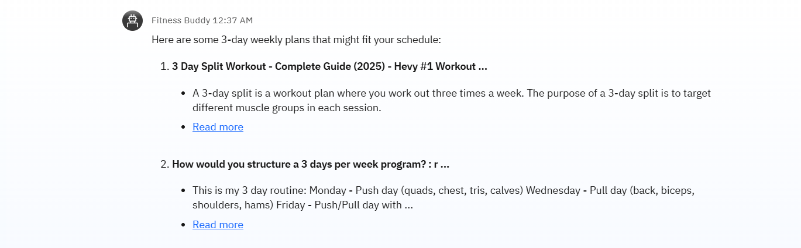
Result
"I struggle with consistency - what 3-day weekly plan?”

Slide 14
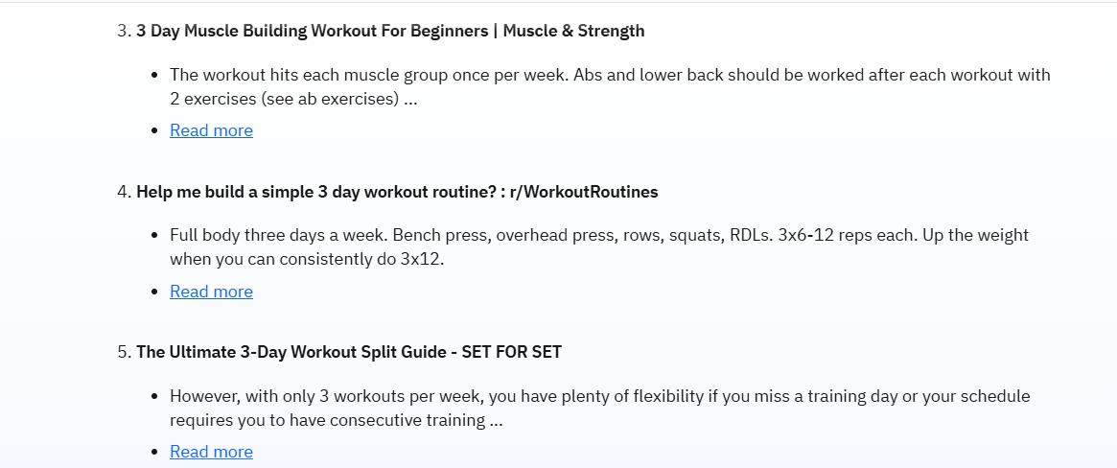
Result
"I struggle with consistency - what 3-day weekly plan?”

Slide 15
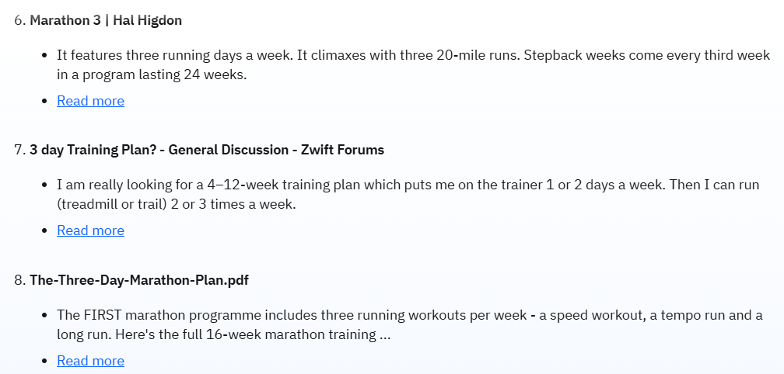
Result
"I struggle with consistency - what 3-day weekly plan?”

Slide 16
Conclusion
Title: Impact & Lessons Learned Content: Benefits
Personalization: Adapts to individual constraints (time/equipment).
Cost-Effective: Free-tier IBM Cloud services minimize expenses.
Challenges
Fine-tuning prompt instructions for safety/disclaimers.
Limited real-time data integration (future scope).

Slide 17
Future scope
Title: Enhancements & Scalability Content: Improvements
Wearable Integration: Sync with Fitbit/Apple Health for progress tracking.
Multilingual Support: Expand accessibility.
Expansion
Mobile app deployment via APIs.
Voice interface (IBM Watson Speech-to-Text).

Slide 18
References
Title: Citations & Resources
Academic & Technical Sources
IBM Watsonx.ai Documentation
"Building Agentic AI with Watsonx.ai" (IBM, 2025).
https://www.ibm.com/watsonx/agent-lab
AI Fitness Coaching
Patel, R. et al. (2024). "Personalized Virtual Trainers: A Survey of AI in Fitness." Journal of HealthTech AI.
Prompt Engineering
Liu, Y. (2023). "Optimizing LLMs for Domain-Specific Tasks." IEEE Transactions on AI.
Project Repository Link: https://github.com/EshaSing17/Fitness_Buddy.git

Slide 19
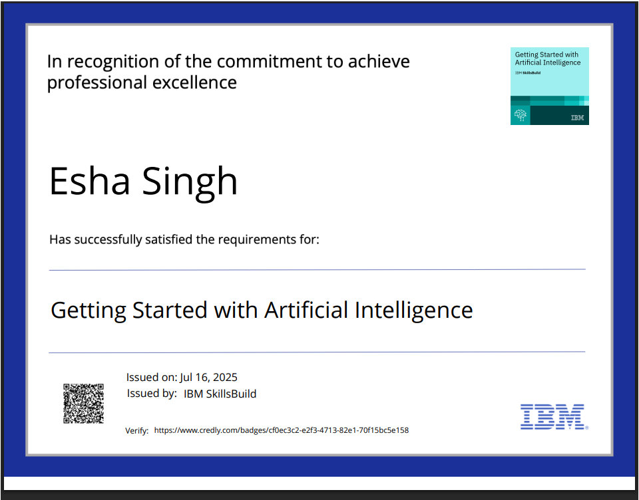
IBM Certifications
Screenshot/ credly certificate( getting started with AI)

Slide 20
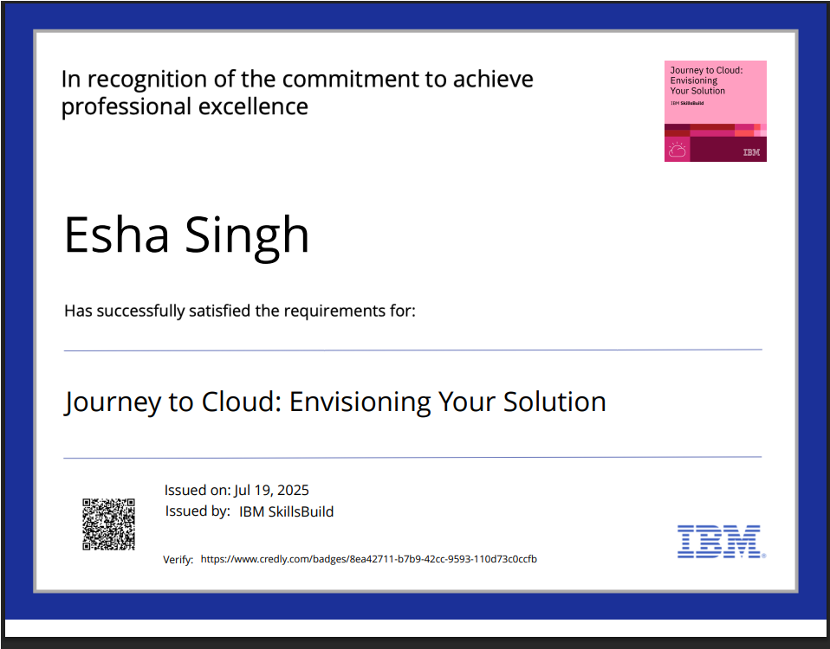
IBM Certifications
Screenshot/ credly certificate( Journey to Cloud)

Slide 21
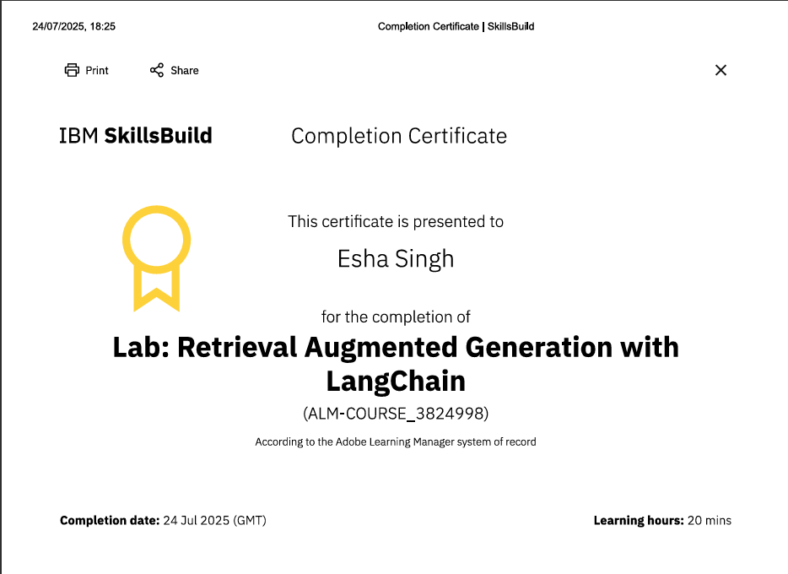
IBM Certifications
Screenshot/ credly certificate( RAG Lab)

Slide 22
THANK YOU

